Slide 1

C.A.T.
Charter(networks) Auditing Tool
Edward Ayala | Senior Project

Slide 2
Project Timeline
Planning Phase
Plan the steps for manually breaking into a Wi-Fi network
Development Phase I
Using Python, simulate the manual process of breaking into a Wi-Fi network.
Development Phase II
Generate a wordlist using the password structure of Charter Spectrum networks.
Compilation Phase
Combine capture, validation, and decryption processes

Slide 3
Planning phase
ideas and concepts

Slide 4
Manually Breaking Into Wi-Fi
This is a topic I had already known about before starting this project, I had made my own attempts at getting “free” Wi-Fi ever since I got my first computer.
Familiarizing myself with the various tools available on the internet, I used manuals and tutorials to find the best options to use and accommodate each tool to what I needed it for.
Tools I used:
Aircrack-ng Suite
Aircrack-ng
Airmon-ng
Airodump-ng
Aireplay-ng
Wash
Pyrit

Slide 5
The Tools – Aircrack-ng Suite
The Aircrack-ng is a complete suite of tools to assess Wi-Fi network security.
Monitoring: Packet capture and export of data to text files for further processing by third party tools
Airodump-ng
Attacking: Replay attacks, deauthentication, fake access points and others via packet injection
Aireplay-ng
Testing: Checking Wi-Fi cards and driver capabilities (capture and injection)
Airmon-ng
Cracking: WEP and WPA PSK (WPA 1 and 2)
Aircrack-ng

Slide 6
The Tools – Wash & Pyrit
Wash is a tool designed to scan for WPS enabled networks and their main characteristics.
Part of the Reaver toolset used for attacking WPS enabled networks, although I just use it to scan for networks
Pyrit is a tool similar to Aircrack that can be used to decrypt captured Wi-Fi passwords using Multi-core CPUs and GPU power.
I only use this tool to verify the passwords I capture from the networks.

Slide 7
Prepare the devices
Using Airmon-ng to setup the device to attack networks
Search for networks
Using Airodump-ng/Wash to find potential targets
Select and parse target details
Log target information and find any clients/devices connected to the target
Attack the network
Using Airodump-ng concurrently with Aireplay-ng to deauthorize clients and capture the password
Decrypt the password
Using Aircrack-ng concurrently with the wordlist generator program to decrypt the password

Slide 8
Development Phase I
python and command line

Slide 9
The Idea
Automate the manual process:
Discovering target networks
Attacking a target
Capture the password

Slide 10
Running Commands Through Python
Using Python’s Subprocess library to run system commands
Subprocess allows python to run system commands as if they were being manually typed.
Features of Subprocess library:
Capture output – Instead of producing output in the PC s console window, the program can run commands in the background and capture the output for parsing / logging.
Separates all aspects of running a command into manageable pieces – output, input arguments, errors, & return codes
Example: subprocess.run(“command”, capture_output=True, text=True)
subprocess.Popen(“command”, stdout=subprocess.PIPE)

Slide 11
Gathering Information - Networks
The first step to breaking into networks is to search for surrounding networks
Using Wash – a tool that scans for WPS enabled networks
This tool can also be used to gather useful information about networks such as:
BSSID (Unique identifier)
Channel
Power-level (Proximity to the network)
ESSID (Network name)
Using Airodump-ng – a tool that scans for networks
This tool is similar to Wash, although it can gather more detailed information

Slide 12
Gathering Information - Clients
Next step is to find any clients (devices) connected to the network
While Wash can only find basic information on the networks, Airodump-ng can collect information about the devices connected to the networks.
The client information is crucial on successfully attacking the network.
[CH 10 ][ Elapsed: 36 s ][ 2020-03-12 18:36 ][ WPA handshake: A0:63:91:E3:41:C9 ]
BSSID PWR RXQ Beacons #Data, #/s CH MB ENC CIPHER AUTH ESSID
A0:63:91:E3:41:C9 -55 97 324 410 0 10 405 WPA2 CCMP PSK MyCharterWiFic9-2G <--- NETWORK
BSSID STATION PWR Rate Lost Frames Probe
A0:63:91:E3:41:C9 02:0F:B5:05:41:27 -84 0 - 1e 0 13 <--- CLIENT
A0:63:91:E3:41:C9 02:0F:B5:1C:8A:04 -85 0 - 1e 0 13 <--- CLIENT
A0:63:91:E3:41:C9 02:0F:B5:6B:0D:19 -83 0 - 1e 0 11 <--- CLIENT
A0:63:91:E3:41:C9 02:0F:B5:FB:E2:BA -84 1e- 1e 0 676 <--- CLIENT
A0:63:91:E3:41:C9 02:0F:B5:5F:6B:66 -83 0 - 1e 0 11 <--- CLIENT

Slide 13
Attacking The Target
Using the gathered information, the next step is to attack the target
The Aireplay-ng tool has the capability to send “deauthorization” packets to the network and any connected devices to force them to disconnect from the network.
Using this tool in conjunction with Airodump-ng to capture all packets within the network while also sending deauthorization packets with Aireplay-ng makes it possible capture the network password.

Slide 14
Capturing The Password
When a client (device) is forced to disconnect from the network with Aireplay-ng it automatically reconnects on its own.
Capturing all traffic on the network while this happens means that the password authentication packets will be captured as well.

Slide 15
Disconnected by Aireplay-ng
DEVICE
NETWORK
RECONNECT
Capturing all traffic with Airodump-ng

Slide 16
Development Phase II
wordlists and password structures

Slide 17
The Password Structure
Charter Spectrum networks are set up with passwords that all follow the same structure.
Adjective + Noun + 3 Numbers
All lowercase
Examples:
heavyapple395
gentlekayak053
This is so the password is easy to remember, easy to enter, and easy to communicate.

Slide 18
Time To Decrypt Comparison
All ISPs (Internet Providers) have their own default password, some follow a similar structure to Charter Spectrum while others have their own structure. A comparison between the time it would take to decrypt using a method that tries every possible combination of characters.
Service Provider | Password Structure | Time To Decrypt
Charter Spectrum | Adjective + Noun + ### | ~16 days
Comcast Xfinity | Adjective + ###(#) + Noun | ~16 days - 5 months
AT&T | 12-15 Characters (a-z, Symbols, Numbers) | ~3 trillion years
SOURCE: https://www.my1login.com/resources/password-strength-test/

Slide 19
Finding Words
Spending a few minutes on Google searching “list of adjectives” and “list of nouns” I was able to find large lists of each to combine together in the program.
ancient
antique
aquatic
baby
basic
big
bitter
black
blue
bottle
bottled
.
.
.
airplane
apple
automobile
ball
balloon
banana
beach
bird
boat
boot
bottle
.
.
.

Slide 20
Generating The Wordlist
The combination wordlist was generated by a separate Python program that organizes the collected words into arrays then uses double for-loops to run through every possible combination of adjectives and nouns.
for adjective in adjective_list:
for noun in noun_list:
for number in range(1000):
password = adjective + noun + number

Slide 21
Compilation Phase II
process linking and synchronized programs

Slide 22
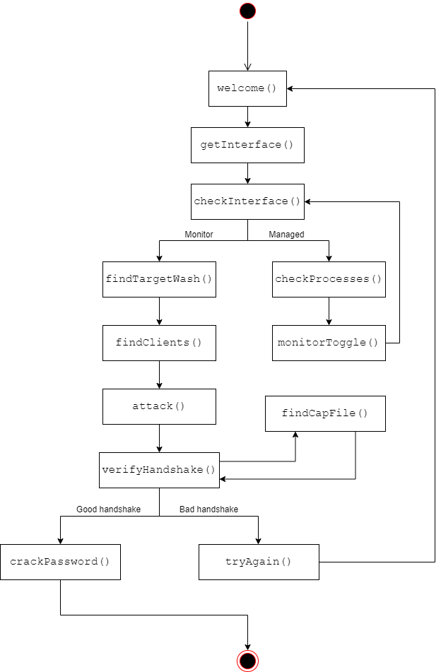
Process Flow

Slide 23
DEMO
demonstration of C.A.T.

Slide 24
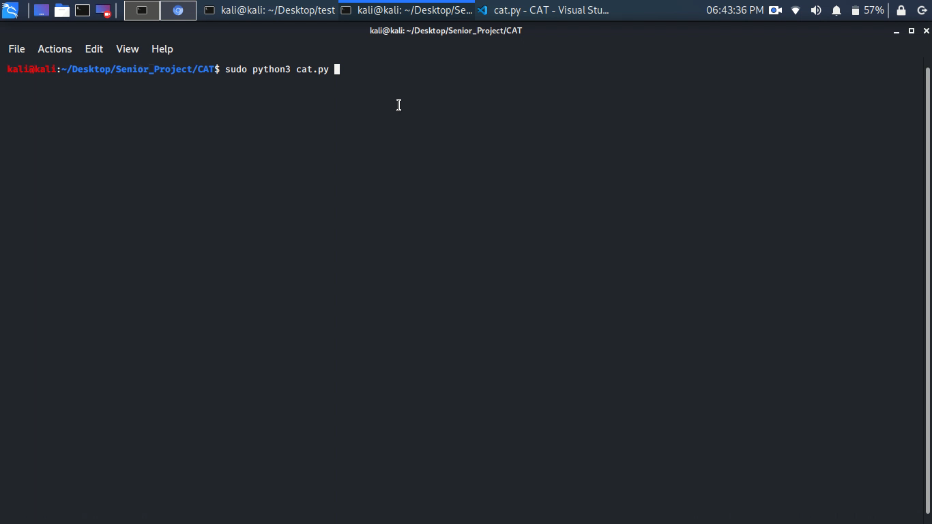

Slide 25
How to protect yourself
change your password

Slide 26
Secure Your Home Network
Simple steps to secure a home network from many attacks like this:
Change your password
Use a readable password
Include a few symbols and numbers
Easy to remember, easy to enter, easy to communicate
Change your network name
Change your Wi-Fi network name to something unique
Makes it hard to identify the ISP and any possible passwords
Be creative, have fun
Hide your network
Disable the network broadcast – this means the Wi-Fi details must be entered manually
Most effective way of preventing outside threats to your network

Slide 27
Details & More Information
Check out the program and code on my GitHub
https://github.com/edwardayala/CAT

